Slide 1
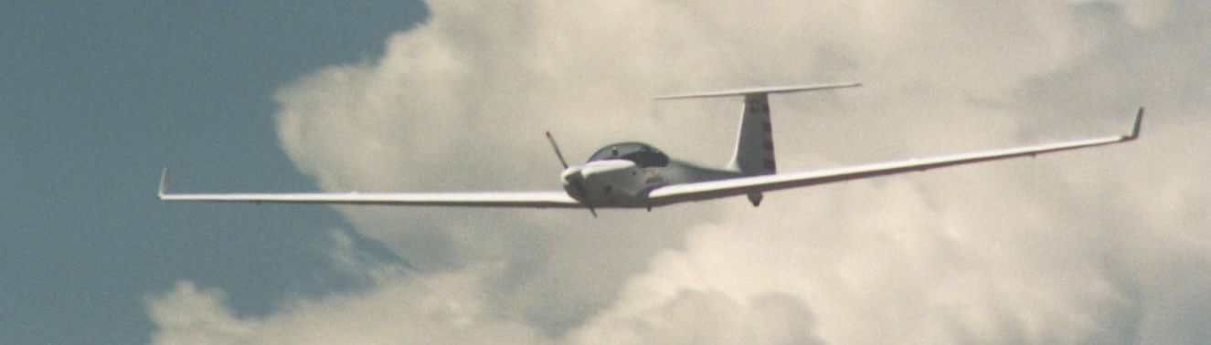
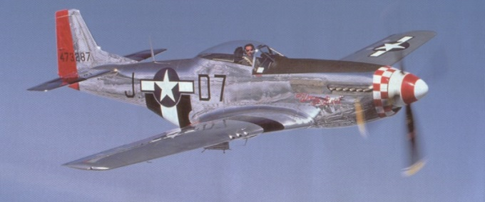
Introduction to Aviation
Young Eagles Program
EAA Chapter 301
Coordinator: Rudy Kniese
Presenter: xxx

Slide 2
A little about xxx

Slide 3
Presentation Outline:
For the Parents
YE Registration Form
Directions to Front Range Airport
What is EAA?
What is Young Eagles, and why was it founded?
What’s in it for you?
The EAA Flight Plan
Some Safety Stuff!
Notes:
Parents – please stay for this first part. Then you can leave if you'd like but please return by 9 pm. I'm not driving anyone home!

Slide 4
Definition of Airplane
A vehicle heavier than air, kept aloft by the lift generated by the passing of air over & under the fixed wings.
And/or driven by propeller, jet propulsion or any similar heavier than air vehicle such as a glider or helicopter.
Notes:
Parents – please stay for this first part. Then you can leave if you'd like but please return by 9 pm. I'm not driving anyone home!

Slide 5
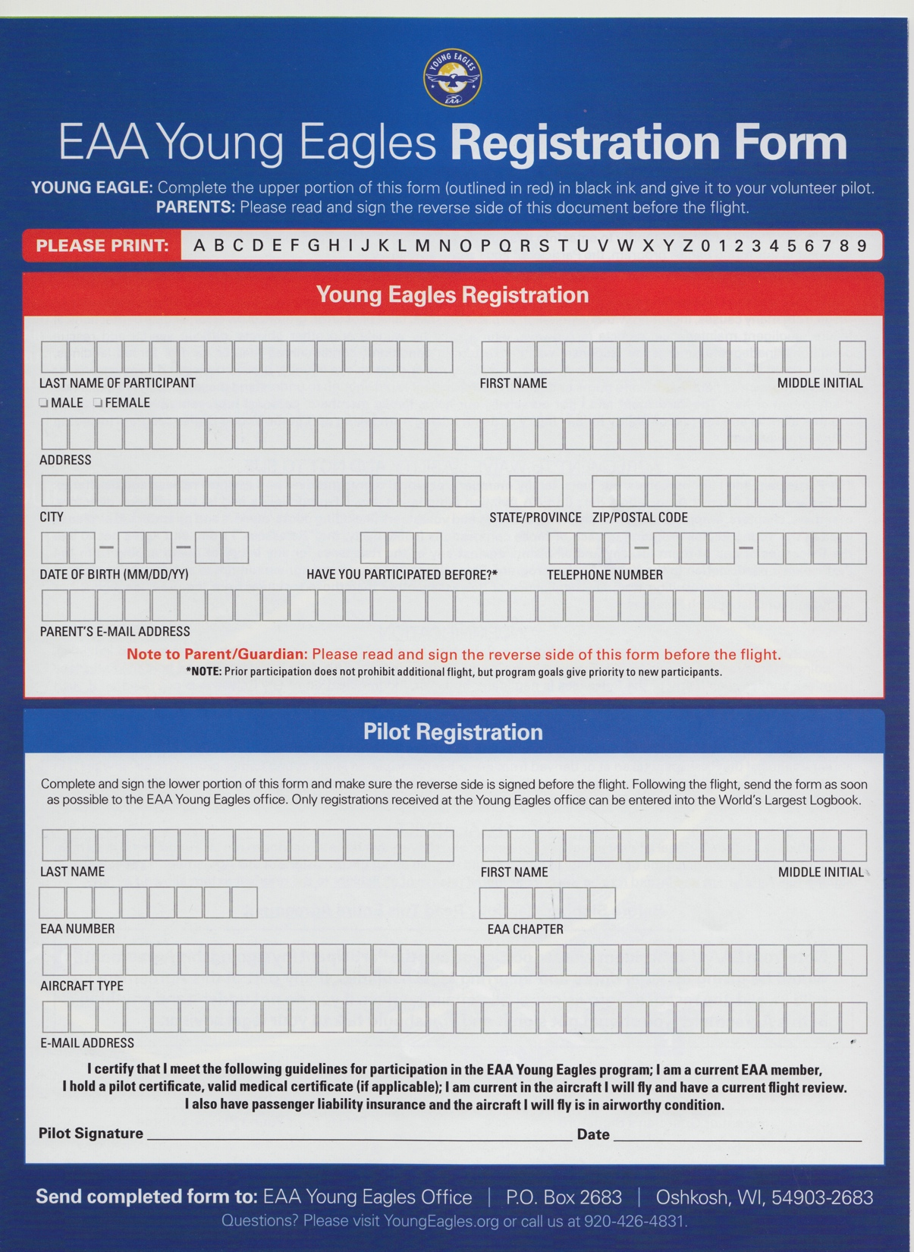
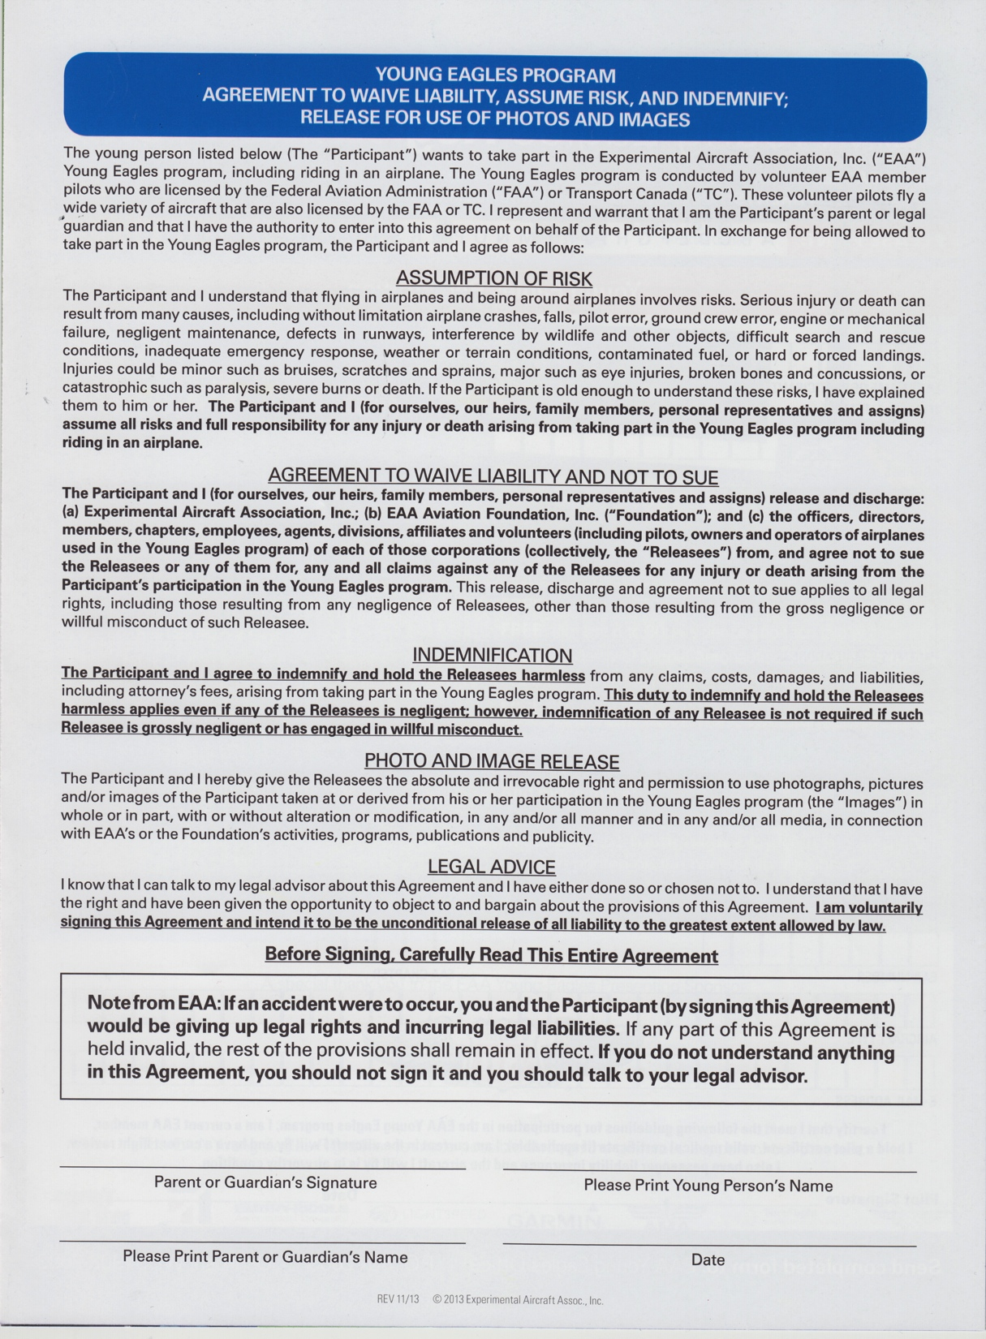

Slide 6
Directions to Front Range Airport:
Get to I-70
I-70 east to exit 295 (unless you live east of Watkins)
Exit north, go right on Colfax, go left on Imboden road, go right on 48th, go left on Front Range Parkway – go to terminal
8:00 AM Start time
Front Range Airport OR 5200 Front Range Pkway
Notes:
How long does it take? FTG is further south than DIA but further east. So however long it takes you to drive to DIA, about the same to FTG
Anyone live east of Watkins?
Different directions:
West on I-70 to exit 299, Manila Rd. Turn north on Manila, across Colfax, across the Railroad tracks. The N-S runway will be on your right. Keep going (about 3 miles) to 48th Ave. There's no street sign, but it's the only left turn possible. You'll see the ATC Tower. Continue west to Front Range Parkway. Big sign!
Turn right, go to the end. On the left is a Colorado Natl Guard base. Keep going. At the end is the Terminal on the right (flag pole).
There are 3 buildings – the terminal, the Executive Hangar (beige) and a big blue hangar, named Big Blue. Park in the Terminal lot or the one just south of the Exec Hangar. We're in the Exec Hangar – look for the EAA YE sign.
Park on the south side of the Exec terminal, walk up the west side, look for EAA YE Sign and enter the west side door.
DO NOT WALK ON THE RAMP!!!
Warning: Manila Rd is has potholes! Big ones!

Slide 7
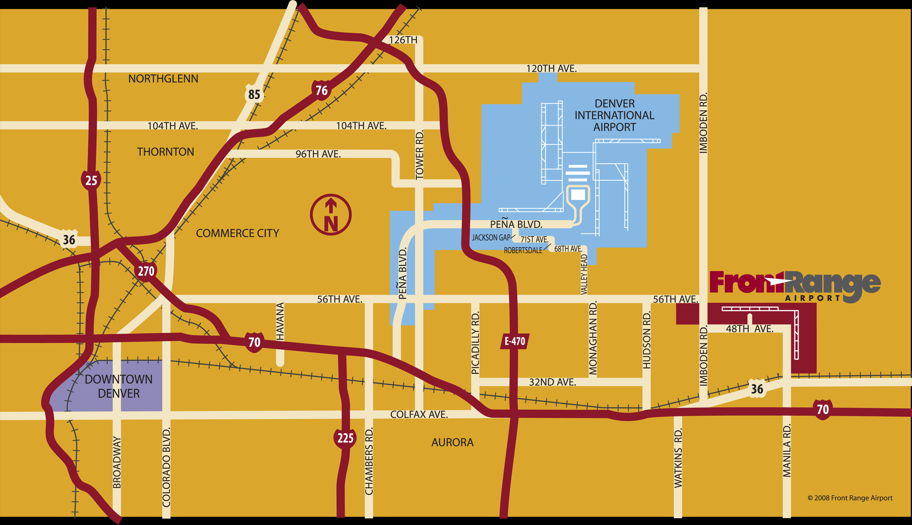
Getting to Front Range Airport:

Slide 8
The Ride Along
Parent MAY ride along in the backseat of 4-place aircraft IF (and Only IF)
The Young Eagle invites the parent and
If the aircraft is 4 seater.
Most of our aircraft are 2-seaters
Selection of aircraft is "luck of the draw". Whichever type of airplane is next, that's the one you fly.
The parent must also sign a waiver (Saturday morning)

Slide 9
Weather
It's going to be Warm then Very Warm –
Wear layers!
Sunglasses & Sunblock!
We only fly in nice weather
Light winds are ok – high winds are not!
Mother Nature doesn't always cooperate
If we need to cancel, Rudy will call the coordinator of your group
Sometimes, it just happens.

Slide 10
Thank you Parents, You're Excused
Please return no later than 9 pm.

Slide 11
Presentation Forward:
What is EAA?
Notes:
Ask audience....

Slide 12
EAA=Experimental Aircraft Association
EAA founded in 1953 – more than 170,000 members world wide
“EAA’s roots are with those that built and restored their own airplanes, but in its few years EAA quickly became an organization that was inviting to all aviation enthusiasts.”
Paul Poberezny – Founder and Chairman of the Board
Experimental Aircraft Association –
March 2008 issue of Sport Aviation
Notes:
This an an international organization, not just the US.
We have people who built their airplanes, bought factory airplanes, and people who don't fly, just love aviation.

Slide 13
What is Young Eagles?
The EAA Young Eagles Program was launched in 1992, developed to welcome young people into the world of aviation.
Original Goal – Fly 1M by 2003
100th anniversary of powered flight
Over 2 Million today!
EAA 301 has flown over 6500!

Slide 14
Why a flight in an Airplane?
Survey of People in Aviation
How many have flown in an Airplane before?
Commercial –vs- Your flight?
Notes:
How to introduce people to aviation? Take them for a ride!
Commercial flight – like riding in a Greyhound bus.
GA Flight – like driving a Ferrari!

Slide 15
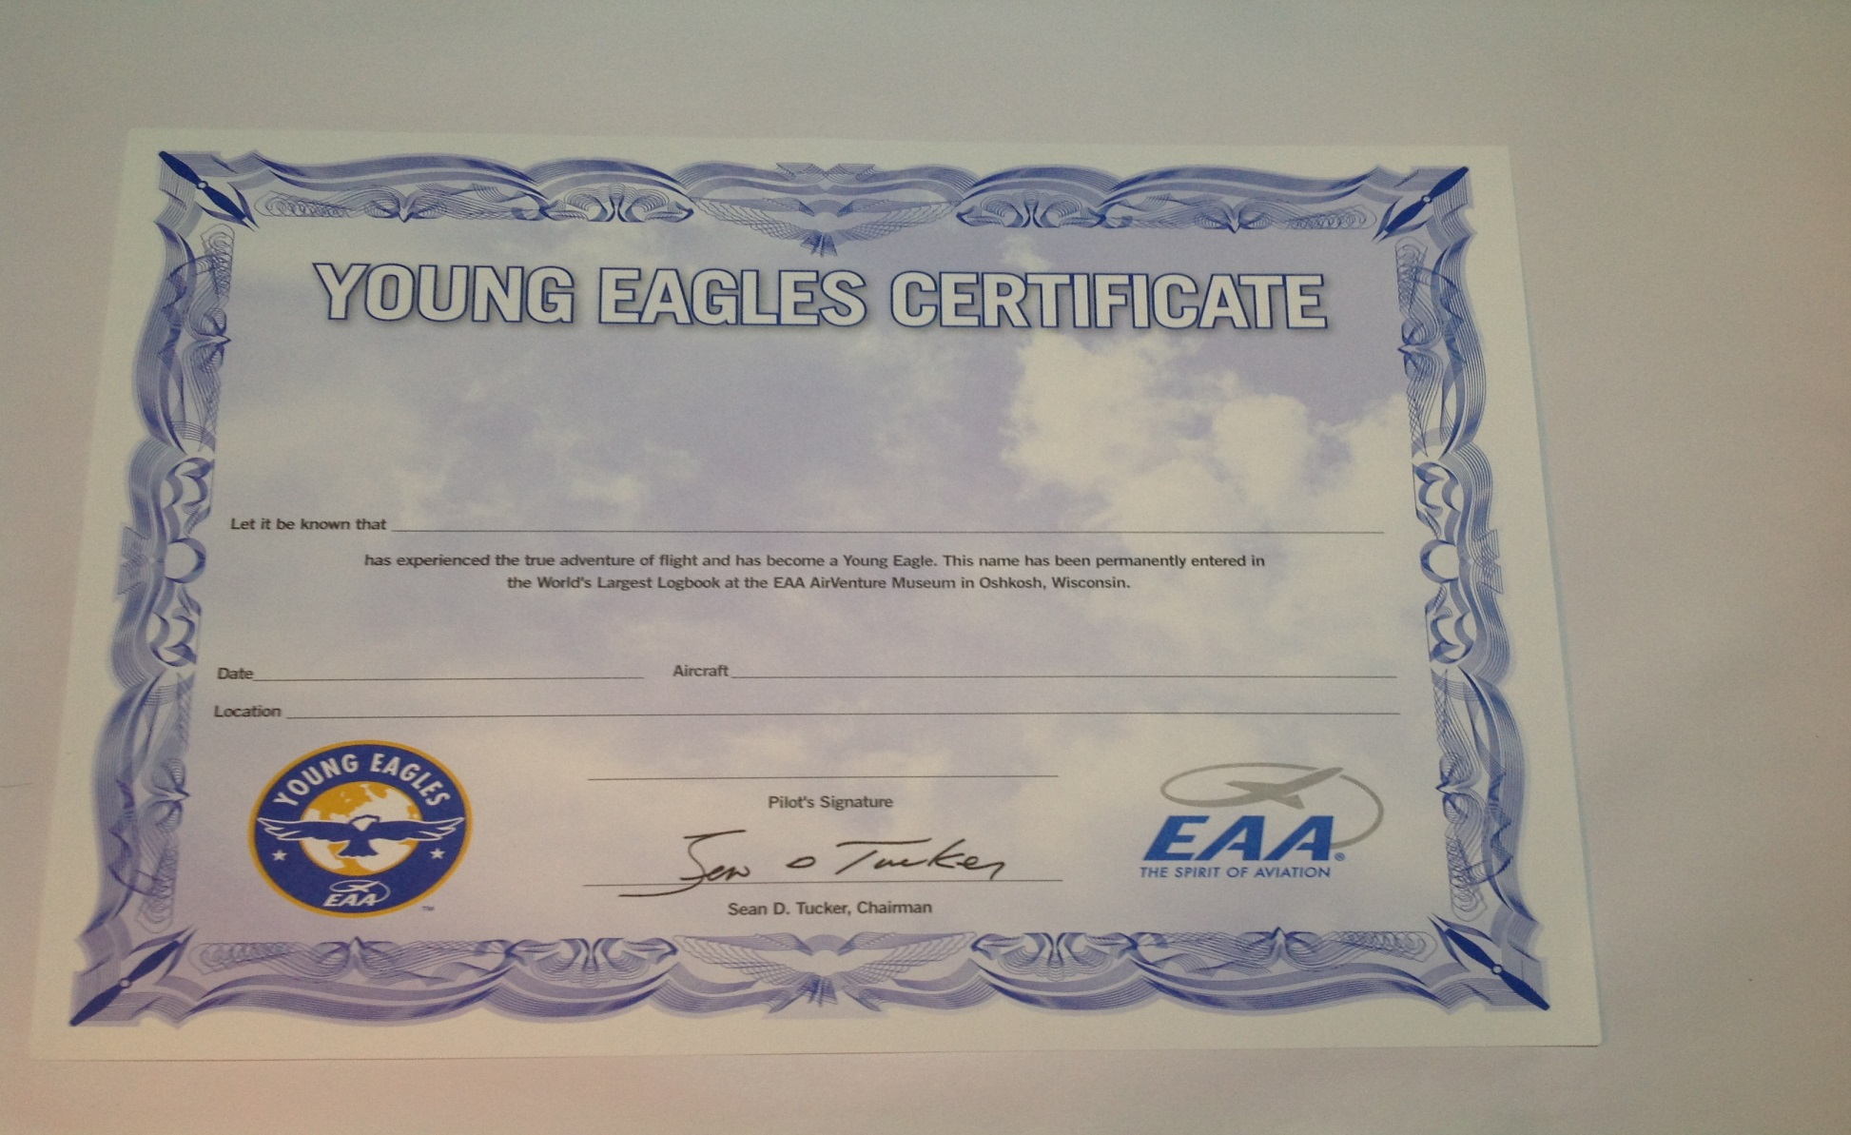
First – YE Certificate

Slide 16
Second - Registration
Registration in the World's largest logbook
Visit the EAA Museum in Oshkosh, WI and look in the book for your name, or
Go to the EAA Young Eagles website and search for your name.
eaa.youngeagles.org

Slide 17
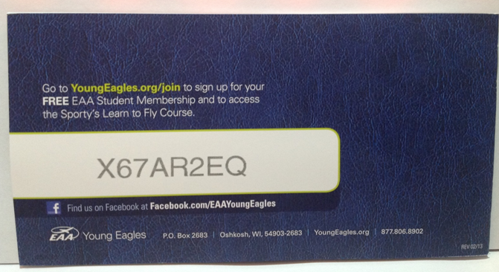
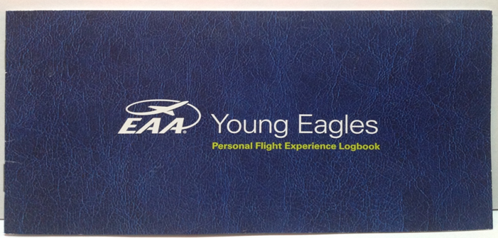
Third – Sporty’s Log book
Sporty’s Log Book & Online Pilot Training & Access Code
Sporty’s Log Book & Pilot training Course – Recommended for ages 13 and older
Notes:
Ground school can be self-study, in a classroom, or online. This is your personal code for the online class. It's self-paced, whenever you want to work on it. When finished you take the knowledge exam.

Slide 18
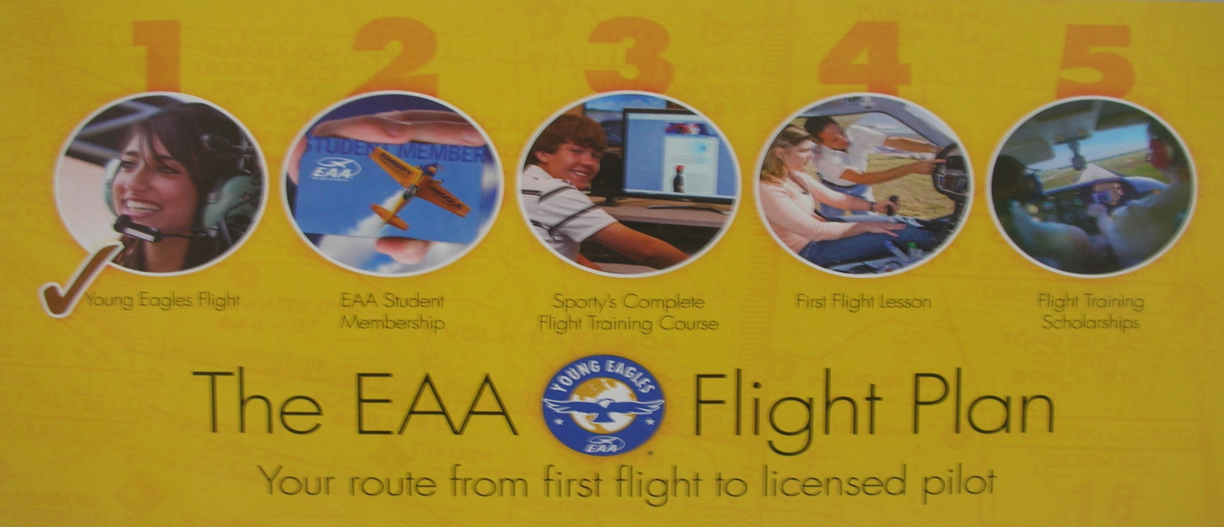
Moving from right seat to left seat
Young Eagle Flight
EAA Student Membership
Sporty’s Flight Training Course
First Flight Lesson
Flight Training Scholarships
Notes:
Logbook is important because when you take your first flight, the CFI (instructor) will enter the information in your log book.
There are a number of flight schools that participate in the First Flight Lesson program. Check the EAA website for names, locations & contact information.

Slide 19
Fourth - If you decide to become a pilot EAA will:
Reimburse the cost of FAA knowledge exam (the Written)
Eligibility
YE between 16 and 19
Completed Sporty’s Pilot Training
Once you pass, send a copy of your results to EAA, and they will send you a check!
Notes:
All because you went thru the YE program, EAA will reimburse you for the exam.

Slide 20
Summary of YE Benefits
On-line training class =$225 (or more)
Free Flight lesson = $125 (or more)
Cost of knowledge exam =$150
Student Membership = Priceless
Total =$500+

Slide 21
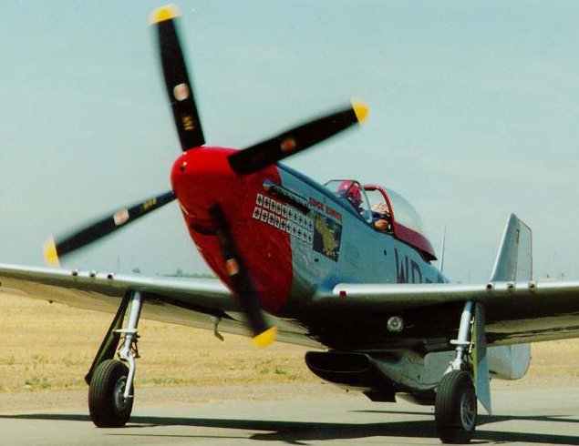
Some Safety Stuff
STAY AWAY FROM THE PROPELLER!!!
“Sterilize” the cockpit!
Listen to the Pilot! –Don’t TOUCH
Notes:
Propellers, even when everything is turned off, can be dangerous
The pilot is very busy when taking off & landing. Listening to radios, looking for traffic, flying the airplane.
Quiet when taking off & landing.
Want to fly? After takeoff, the pilot will ask if you want to fly.
Otherwise, do not touch anything. Do whatever the pilot tells you to do. If the pilot tells you to stick your finger in your nose, do it. Once on the ground, you can ask why your finger is in your nose.
If you have a question, wait until you're back on the ground.

Slide 22
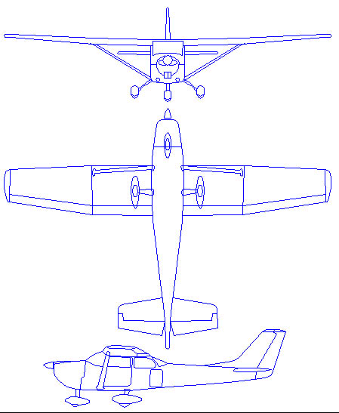
Presentation Outline
Aircraft Basics
Why Aviation/Aerospace?
A Bit of History
Aerodynamics
Control of an aircraft
Propulsion (the Engine)
Cockpit and instruments
Pilot Certificates
Airplane Safety
Fly Day!

Slide 23
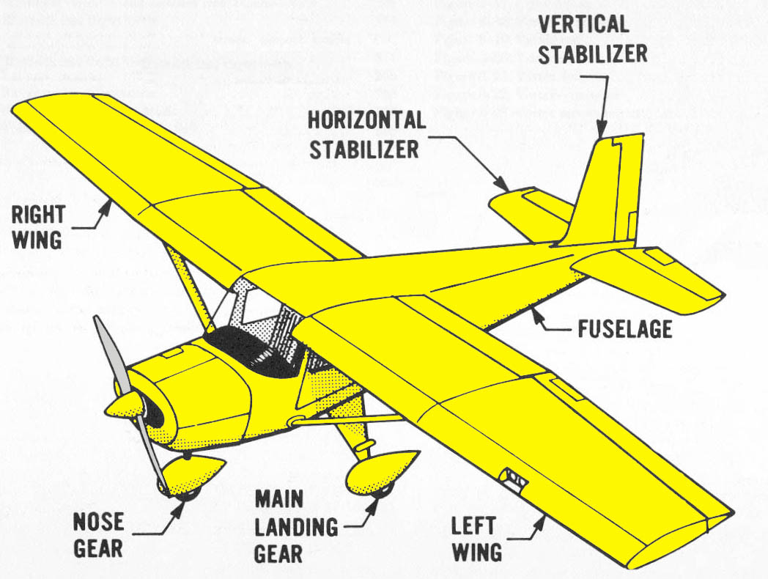
Airplane Basics
Notes:
Go thru the parts. When at the prop, as what it is. Then ask what to do with a prop.
Stay Away!

Slide 24
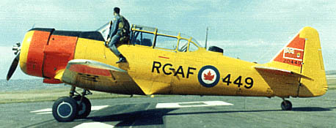
Uses of Aircraft
Transportation
Cargo
Sight Seeing / Pleasure Flying
Aerial Observation
Agricultural
Defense
Search and Rescue
Entertainment / Airshows
Notes:
How many people here have been lost – other than the mall? If you're lost, you'll probably be found by a Civil Air Patrol airplane.
You can join CAP at age 8 and learn to fly gliders at 14.

Slide 25
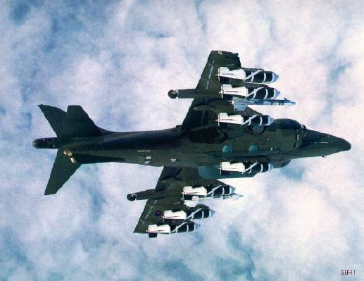
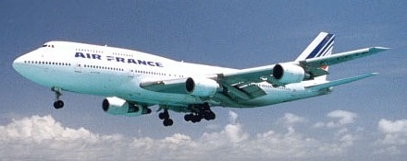
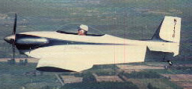
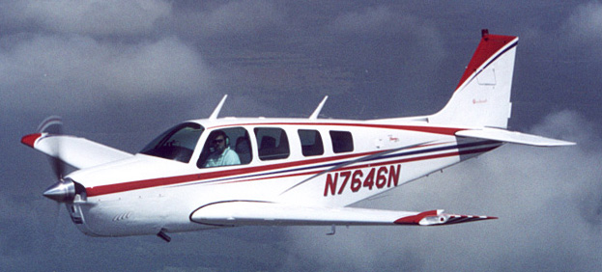
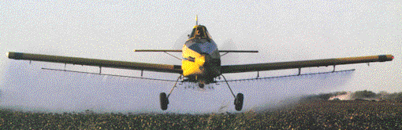
Types of Aircraft
Military
Airliner
General Aviation
Homebuilt
Agricultural
Notes:
Little spots on the 747 is a window. Park it here, and it's bigger than the building. Take the little homebuilt, we can put it in this room and walk around it.
Ag pilots – most agressive flying without being a fighter pilot – and you don't get shot at.

Slide 26
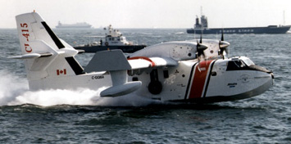
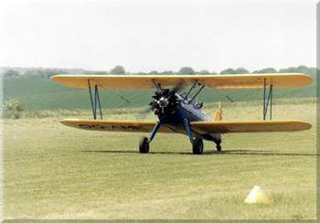
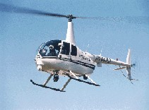
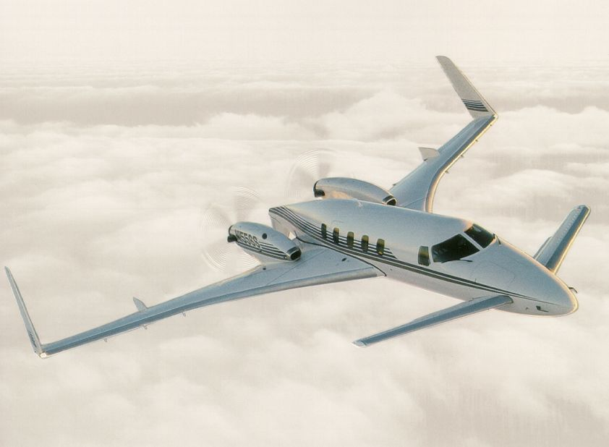
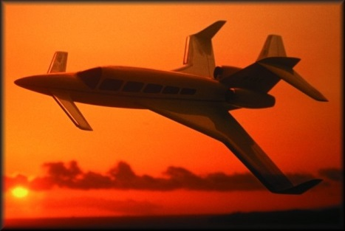
Aircraft Configurations
Seaplane
Biplane
Canard
Conventional
Helicopter
Three Surface

Slide 27
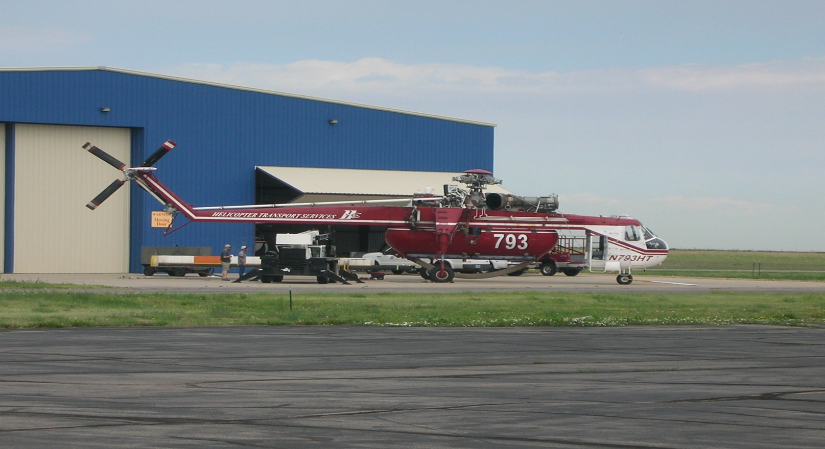
Why Helicopters fly – A fixed wing pilot’s viewpoint

Slide 28
Why Helicopters fly – A fixed wing pilot’s viewpoint
They are so ugly the earth repels them
The rotor beats the air into submission ☺

Slide 29
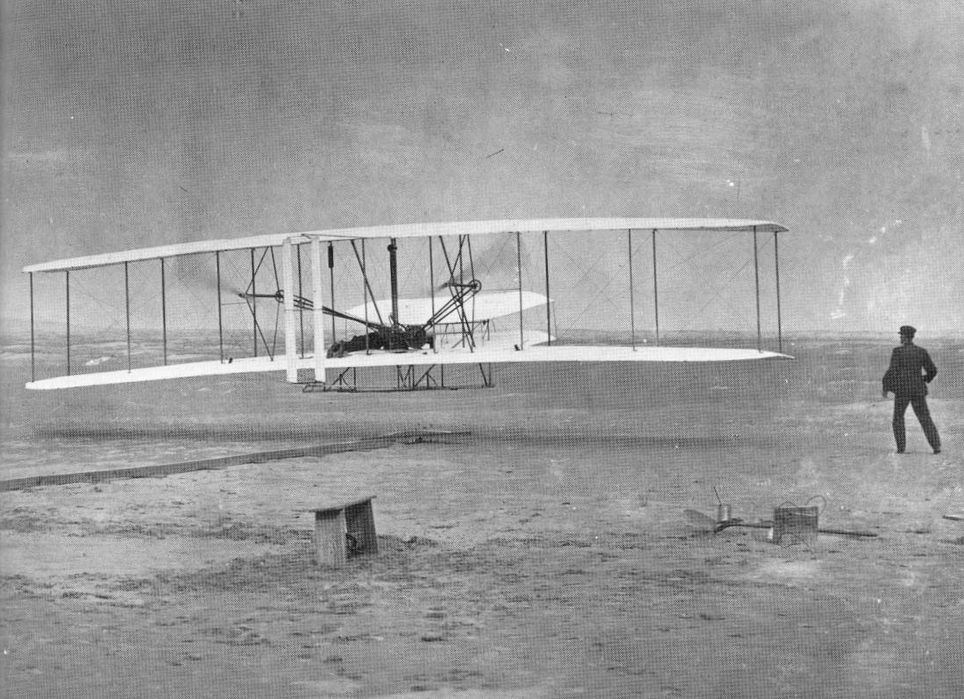
Wright 1903 Flyer
Notes:
29

Slide 30
Wright Flyer Details
1st powered flight
Pilots: Orville and Wilbur Wright
Date: 12-17-03
Flight Time = 12 seconds

Slide 31
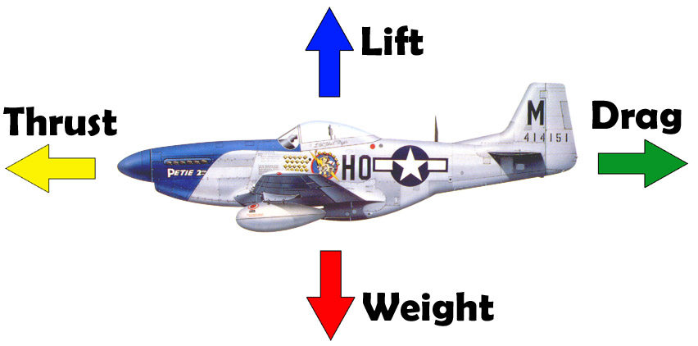
Forces Acting on an Aircraft
For Level Flight, Forces must balance

Slide 32
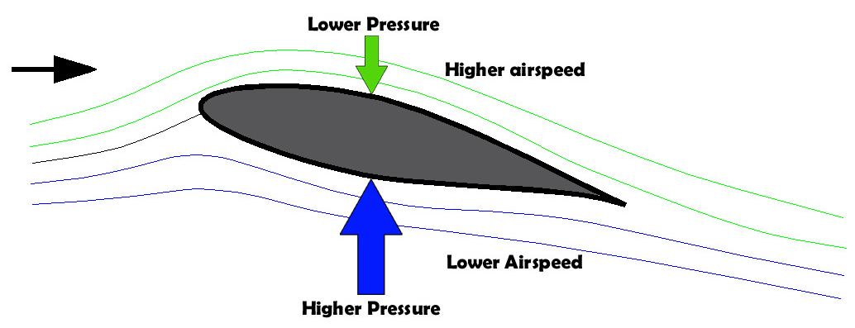
How Lift is Produced
2 related effects produce Lift: Bernoulli’s Principle & Downwash
Bernoulli discovered: As air speeds up it loses pressure
Air naturally speeds up over the top of a wing
The higher pressure below the wing lifts the plane
Downwash happens because of Newton’s 3rd law of motion
For every action there is an equal and opposite reaction
Notes:
Use model of the cross section of the wing. This is an airfoil.
High pressure on top, low pressure on the bottom. In other words, it sucks.
Second part – Newton's 3rd law, for every action there's an equal an opposite reaction.
If you're going to pursue something like aeronautical engineering, you'll probably spend a semester studying this.

Slide 33
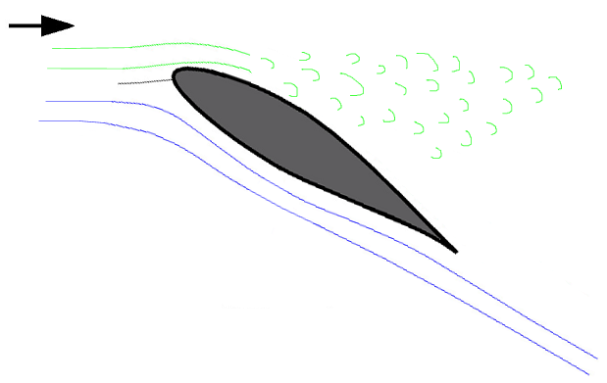
Wing “Stall”
If the wing angle gets too high, the air “separates” and the wing stops producing lift.
Notes:
Critical Angle of Attack.
Use airplane model to illustrate wing angle.
Once the wing stalls, it lowers and there's no more stall.
This is something you learn and demonstrate for your license.
No big deal at altitude.
But what about landing? Don't want to stall close to the ground because there's not enough altitude recover.

Slide 34
Aircraft Stability
The ability of an aircraft to fly straight and level
Glider demonstration
Notes:
Balsa wood glider.
Center of gravity. Where we balance, just like riding your bike.
Where is the CG? Can't go out and balance an airplane on your finger, need to do the math.
Stay in school!
When you move the paper clip, what happens?
True for any and every aircraft. Take it out of CG, bad things happen.

Slide 35
Control
What allows the pilot to fly the airplane in directions other than straight and level.
Demonstration of flight controls on model
Notes:
Use the model with flight controls.

Slide 36
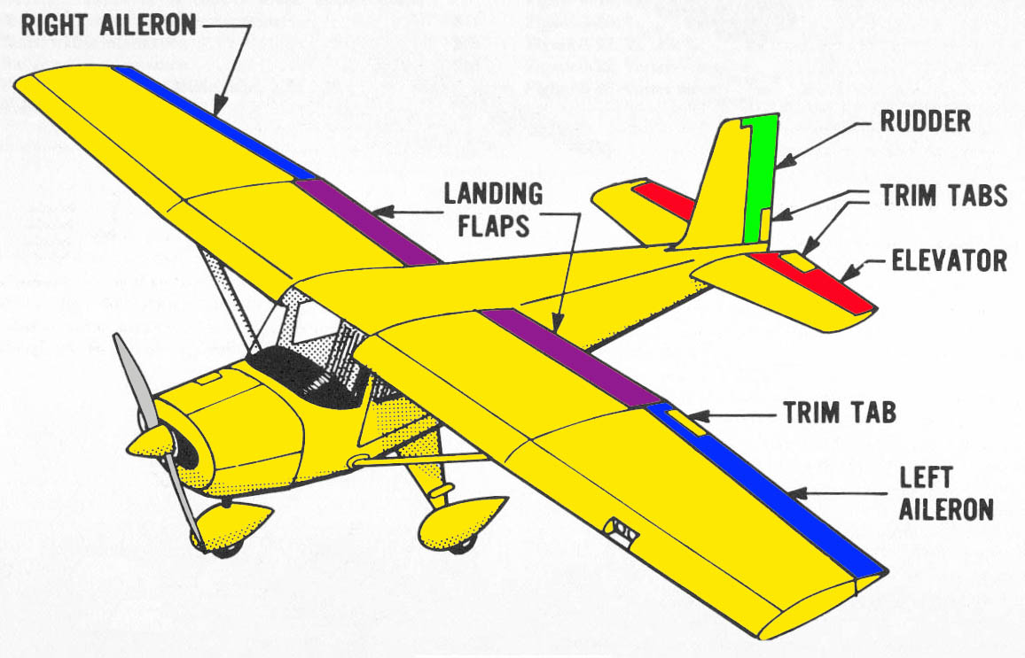
Aircraft Stability and Control Centrifugal Acceleration & Roll
Notes:
Roll, pitch and yaw.
How we turn an airplane. Just like a bicycle! Lean into the turn.
Coordinated turn.
2G Turn.
Fighter pilots & aerobatic pilots go thru 4-8G turns!

Slide 37
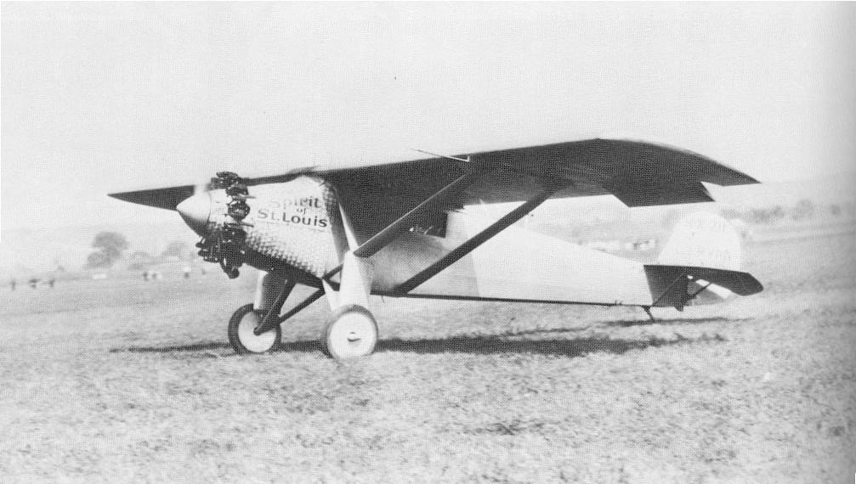
Ryan NYP “Spirit of St. Louis”
Notes:
What's missing on this airplane? the front window!
Non-stop, no refueling. Took out the window and replaced with a fuel tank.

Slide 38
Summary of the Ryan NYP
1st non-stop flight from New York to Paris – May 1927
Pilot – Charles Lindbergh
Prize $ = $25,000
Flight time 33 hours, 30 minutes
Notes:
Wright Bros – 1903.
In a bit over 20 years, went from 12 seconds to 33 hours!
Very similar to what you'll be flying in, about 20 minutes. Think about spending 33 hours in it!

Slide 39
Aircraft Structures
Aircraft must have efficient structures
They MUST very light weight
Aircraft construction materials:
Wood, covered with fabric
Steel tube, covered with fabric
Aluminum
Composite, graphite or fiberglass
Notes:
Show various building materials.
Metal & composite.

Slide 40
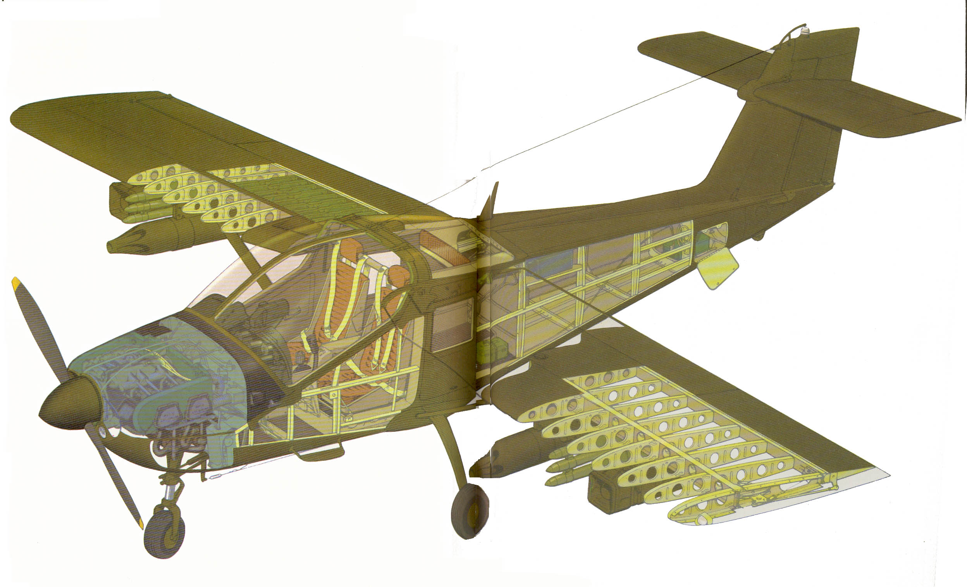
Cutaway View of an Aluminum Aircraft
Notes:
Ribs attach to the spar.

Slide 41
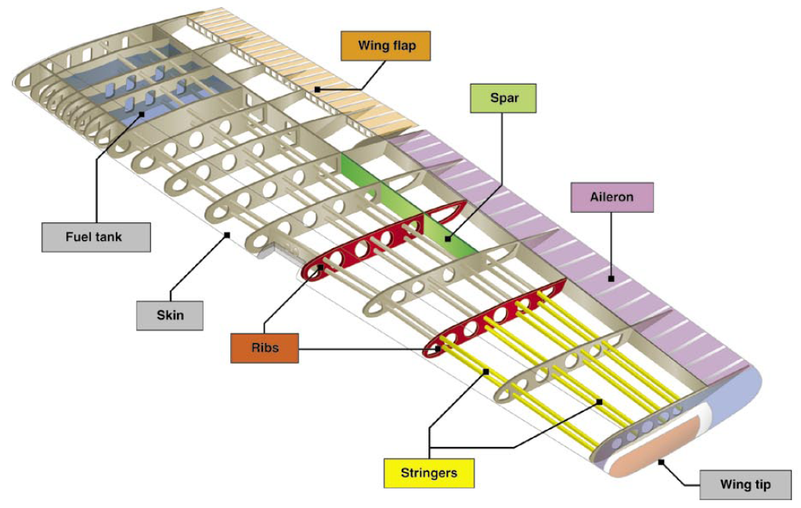
Cutaway View of an Aluminum Wing
Notes:
It's the structure, the shape, that provides the strength.
Holes in the ribs to reduce the weight.
Duct Tape airplane.
Pass around the rib – note the curved edges and rims – make it structurally stronger!

Slide 42
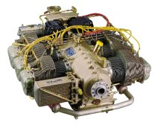
Propulsion – Piston Engines
Most aircraft engines have 4 or 6 cylinders, like cars
Most aircraft engines are air-cooled
A propeller converts the engine power into thrust

Slide 43
Do airplanes crash when the engine stops running?
Notes:
Get variety of answers from the kids.

Slide 44
NO!
Airplanes essentially become gliders when the engine stops running.
They still fly very well, the pilot just needs to look for an airport to land at.

Slide 45
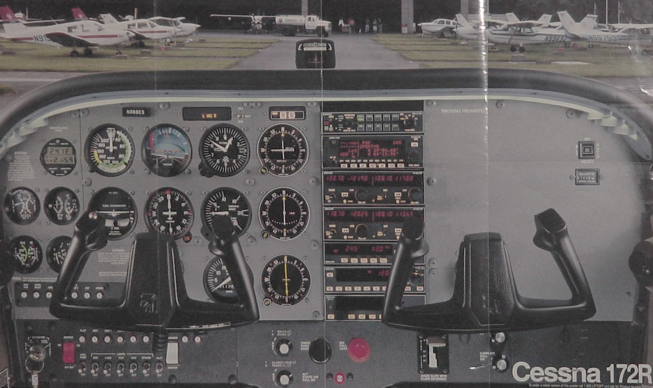
In the Cockpit

Slide 46
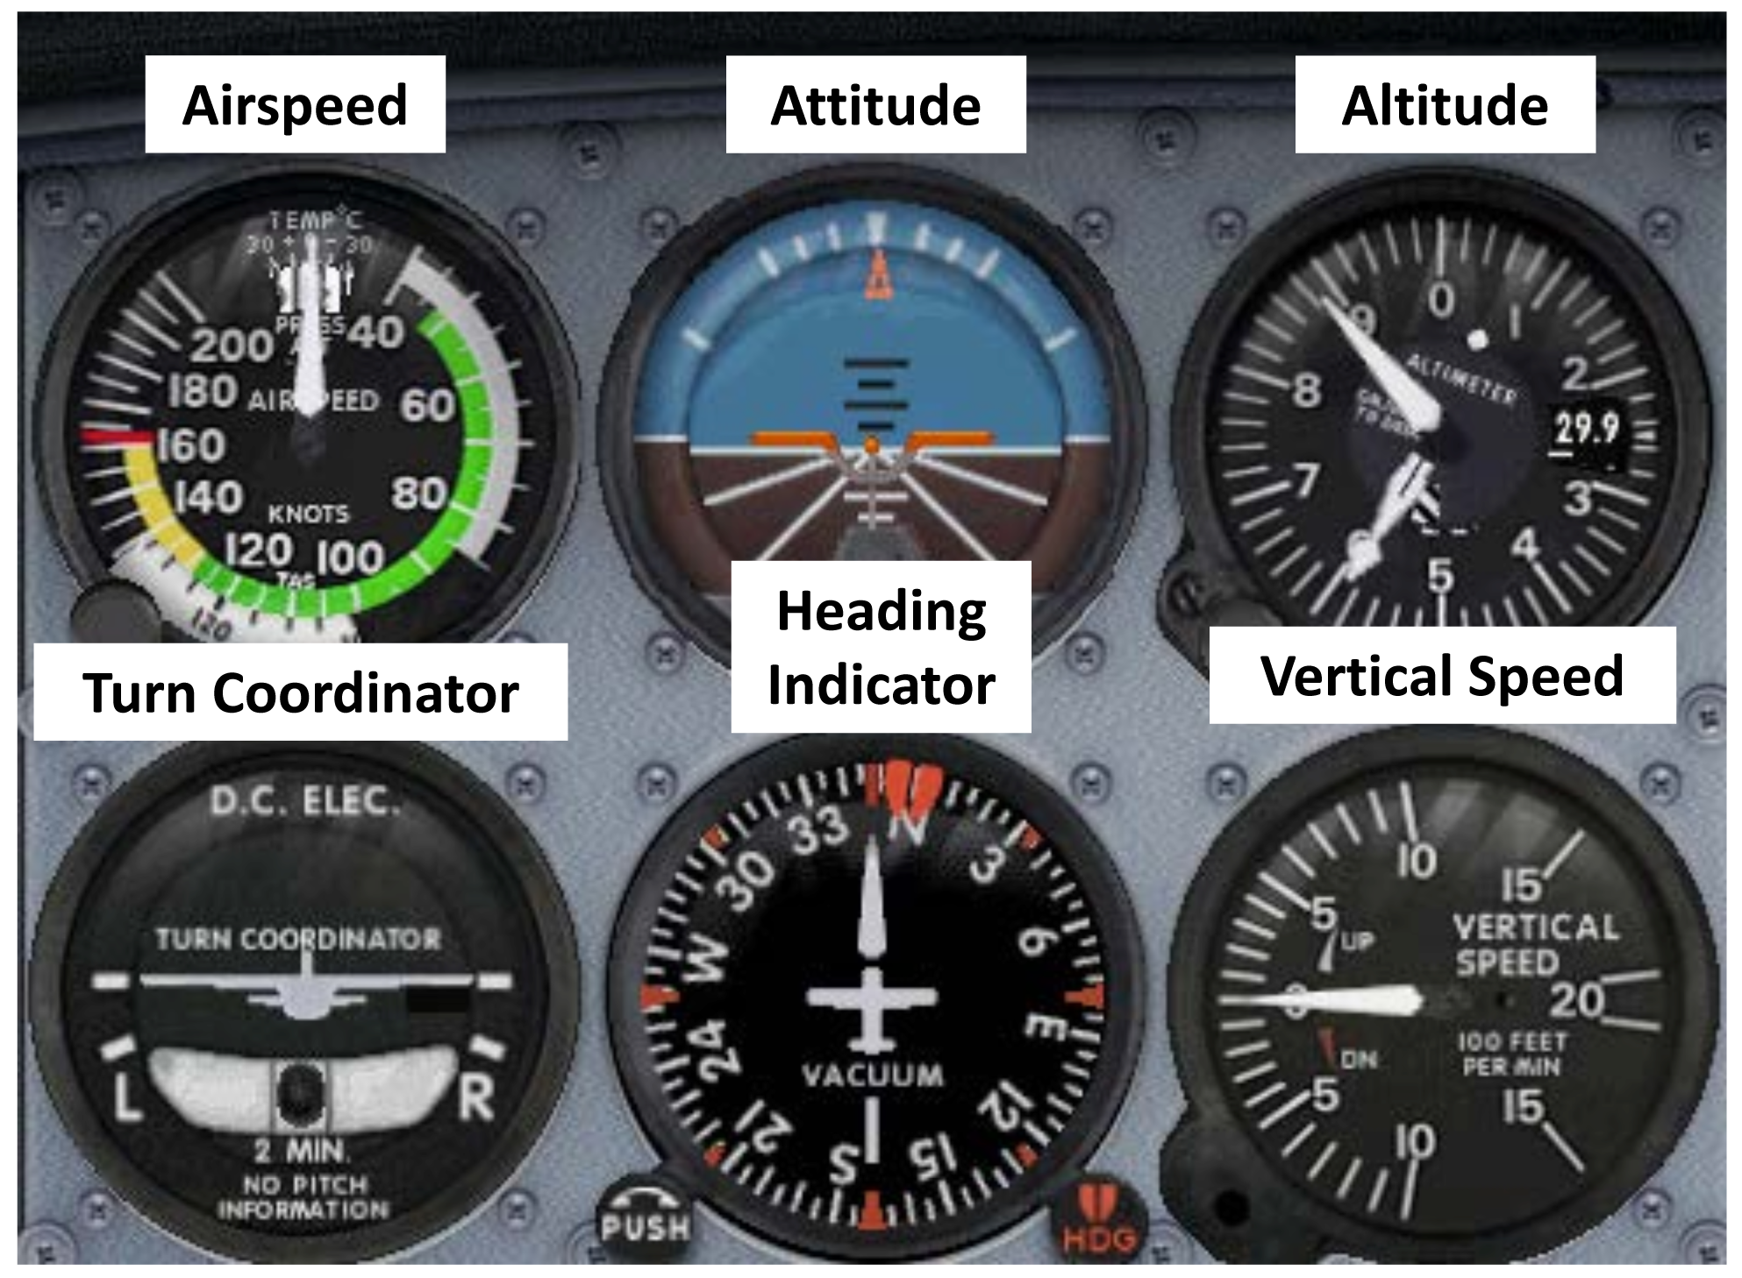
Primary Flight Instruments
The "Six Pack"
Notes:
Everything in aviation is Compass Heading.
Magnetic heading, not true!

Slide 47
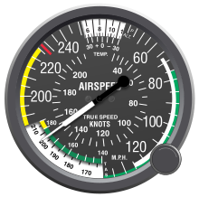
Airspeed Indicator
Use the throttle and pitch of the airplane to make the airplane go faster or slower

Slide 48
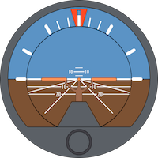
Attitude Indicator
Use the yoke or joystick to turn the airplane (the ailerons) and climb/descend (the elevator)
Shows Roll, Pitch and Yaw

Slide 49
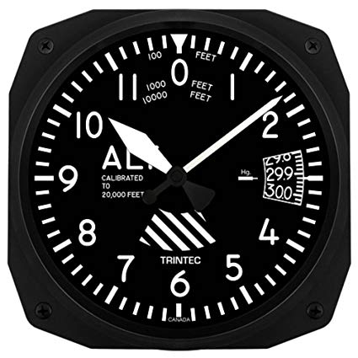
Altimeter
How high are we above Sea Level (not the ground!) – the altitude

Slide 50
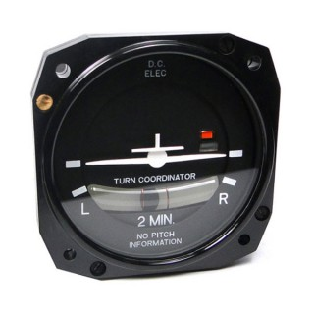
Turn Coordinator
Helps the pilot make a Quality turn
Controlled by the rudder (pedals) and the yoke or joystick

Slide 51
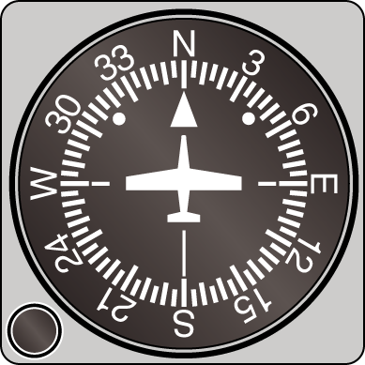
Heading Indicator
What direction are we going?
Controlled by the yoke or joystick to change the ailerons to turn (roll) the airplane

Slide 52
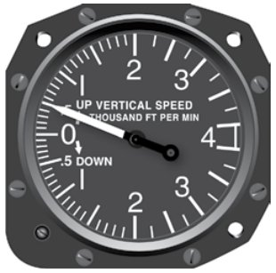
Vertical Speed Indicator
How fast are we climbing or diving?

Slide 53
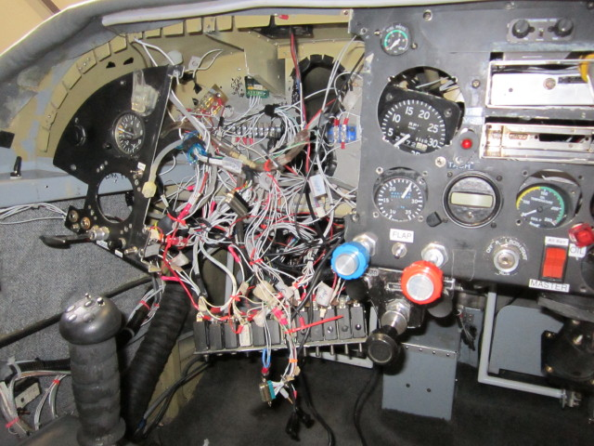
Oops
Run if you see one like this

Slide 54
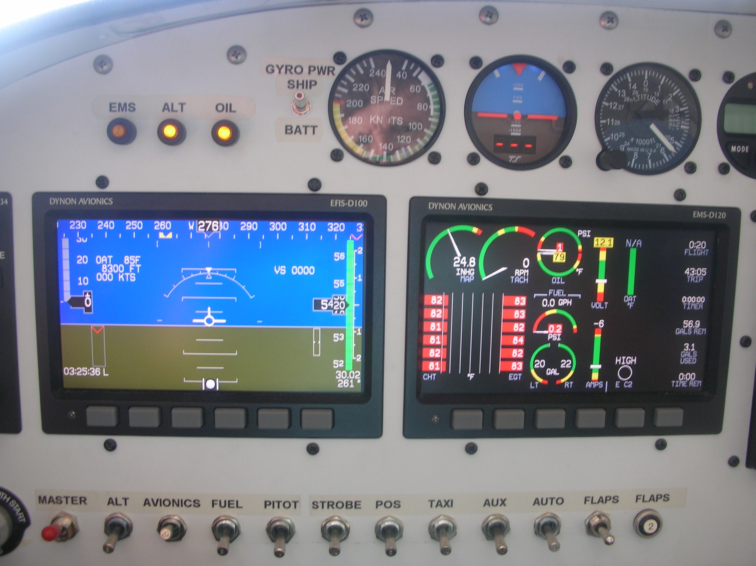
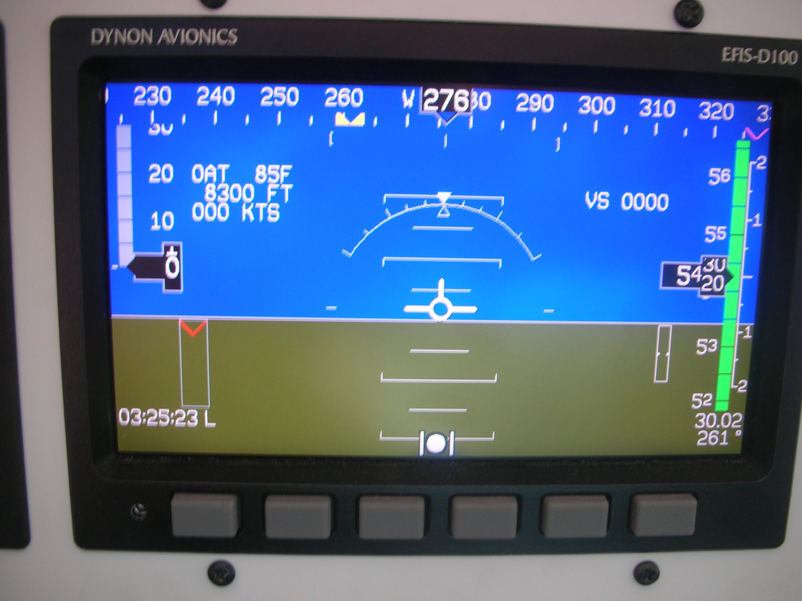
Notes:
“Glass panel”
The tv screen on the left has the 6-pack in a different way. But the analog Airspeed and AI displays are at the top “just in case”
The tv screen on the right is the “status” of the engine. Displays fuel, oil, what’s going on in each of the cylinders in the engine, temperature, and so on.

Slide 55
Notes:
Most of your time should be looking out the window, not at the screens.

Slide 56
Pilot Certificates
Student Pilot: A pilot in training
Sport Pilot: A Pilot authorized for fly Light Sport Aircraft only (LSA) .
Private Pilot: Pilot may fly for pleasure and business but can't get paid
Commercial Pilot: Get paid to fly
Airline Transport Pilot (ATP): A pilot who flys for a scheduled airline or very large airplane.

Slide 57
More about Sport Pilot:
Sport Pilot: A Pilot authorized to fly Light Sport Aircraft only (LSA’s)
Have a maximum gross weight of 1,320 lbs
Maximum stall speed of 45 knots
Unpressurized cabin
Fixed or ground adjustable propeller
Maximum speed in level flight of 120 knots
One or two person occupancy
Fixed landing gear (seaplane may retract)
Single reciprocating Engine

Slide 58

Notes:
Don't do stupid.
Don't post stupid on social media.

Slide 59
Careers in Aviation
In the Air - Pilot
Airline
Corporate/Cargo
Military
Agriculture
Flight Instructor
Flight Attendant
On the Ground
Air Traffic Controller
Aircraft Mechanic
Aircraft Builder
Airport Manager
Ramp Rat
Notes:
Mention education for each topic.
Ag pilot – same excitement as a jet fighter pilot but no one shooting at you!

Slide 60
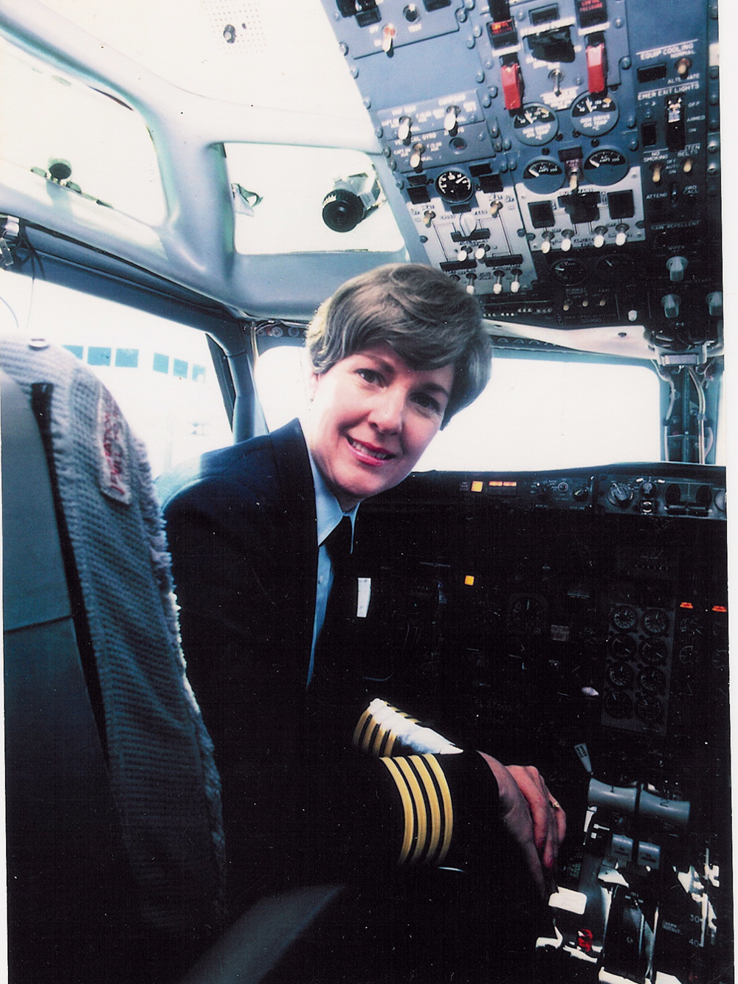
Emily Howell Warner
First female captain of a major airline – Frontier in 1973
Uniform is on display at Wings Over the Rockies

Slide 61
Rules for Airport & Airplane Safety
Stay away from propellers
Stay off of runways and stay clear of taxiing aircraft
Wear seatbelt at all times
Obey all instructions from the pilot & ground crew
In general, do not touch aircraft
When entering and exiting an aircraft, watch for “NO STEP” signs
Don’t bother the pilot during take-off and landing

Slide 62
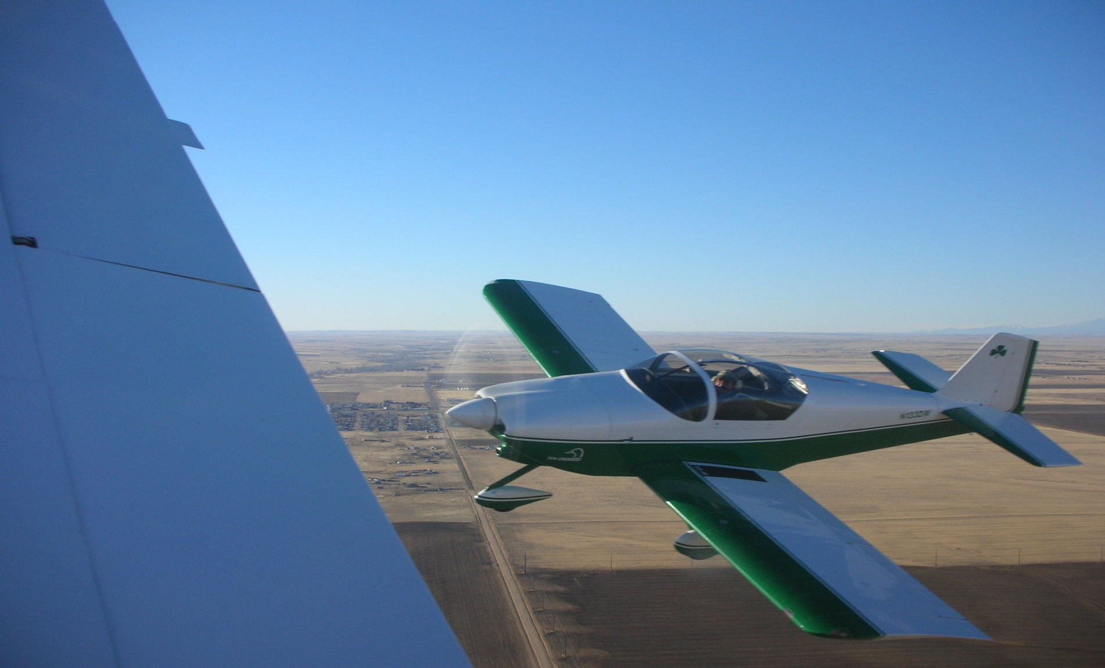
A Picture Preview of your Young Eagle Day

Slide 63
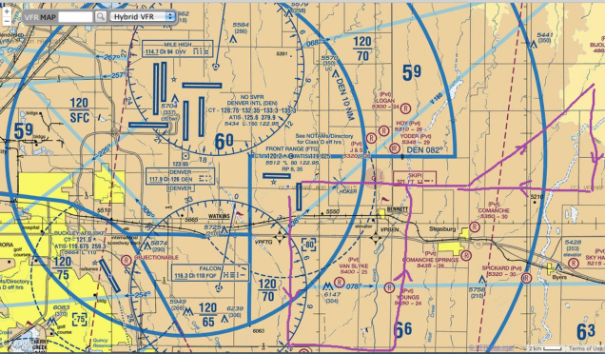
Where we'll be flying

Slide 64
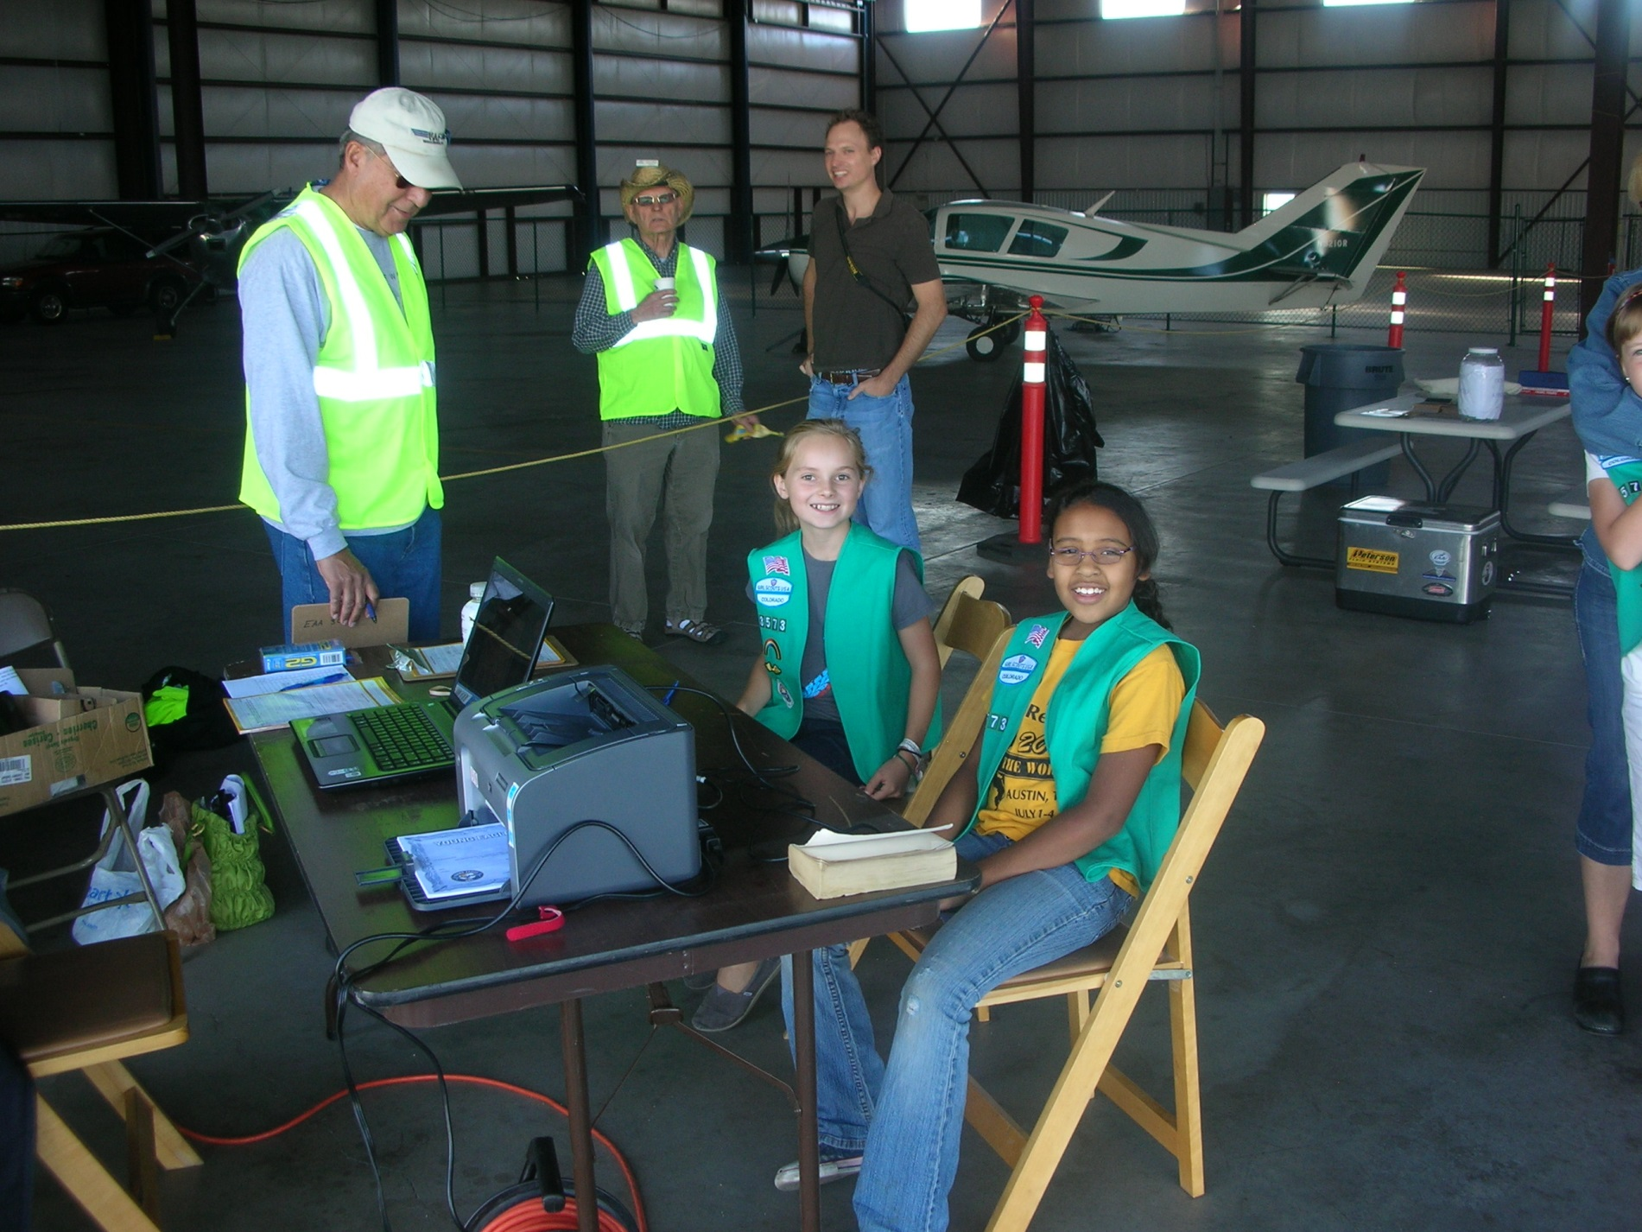

Slide 65
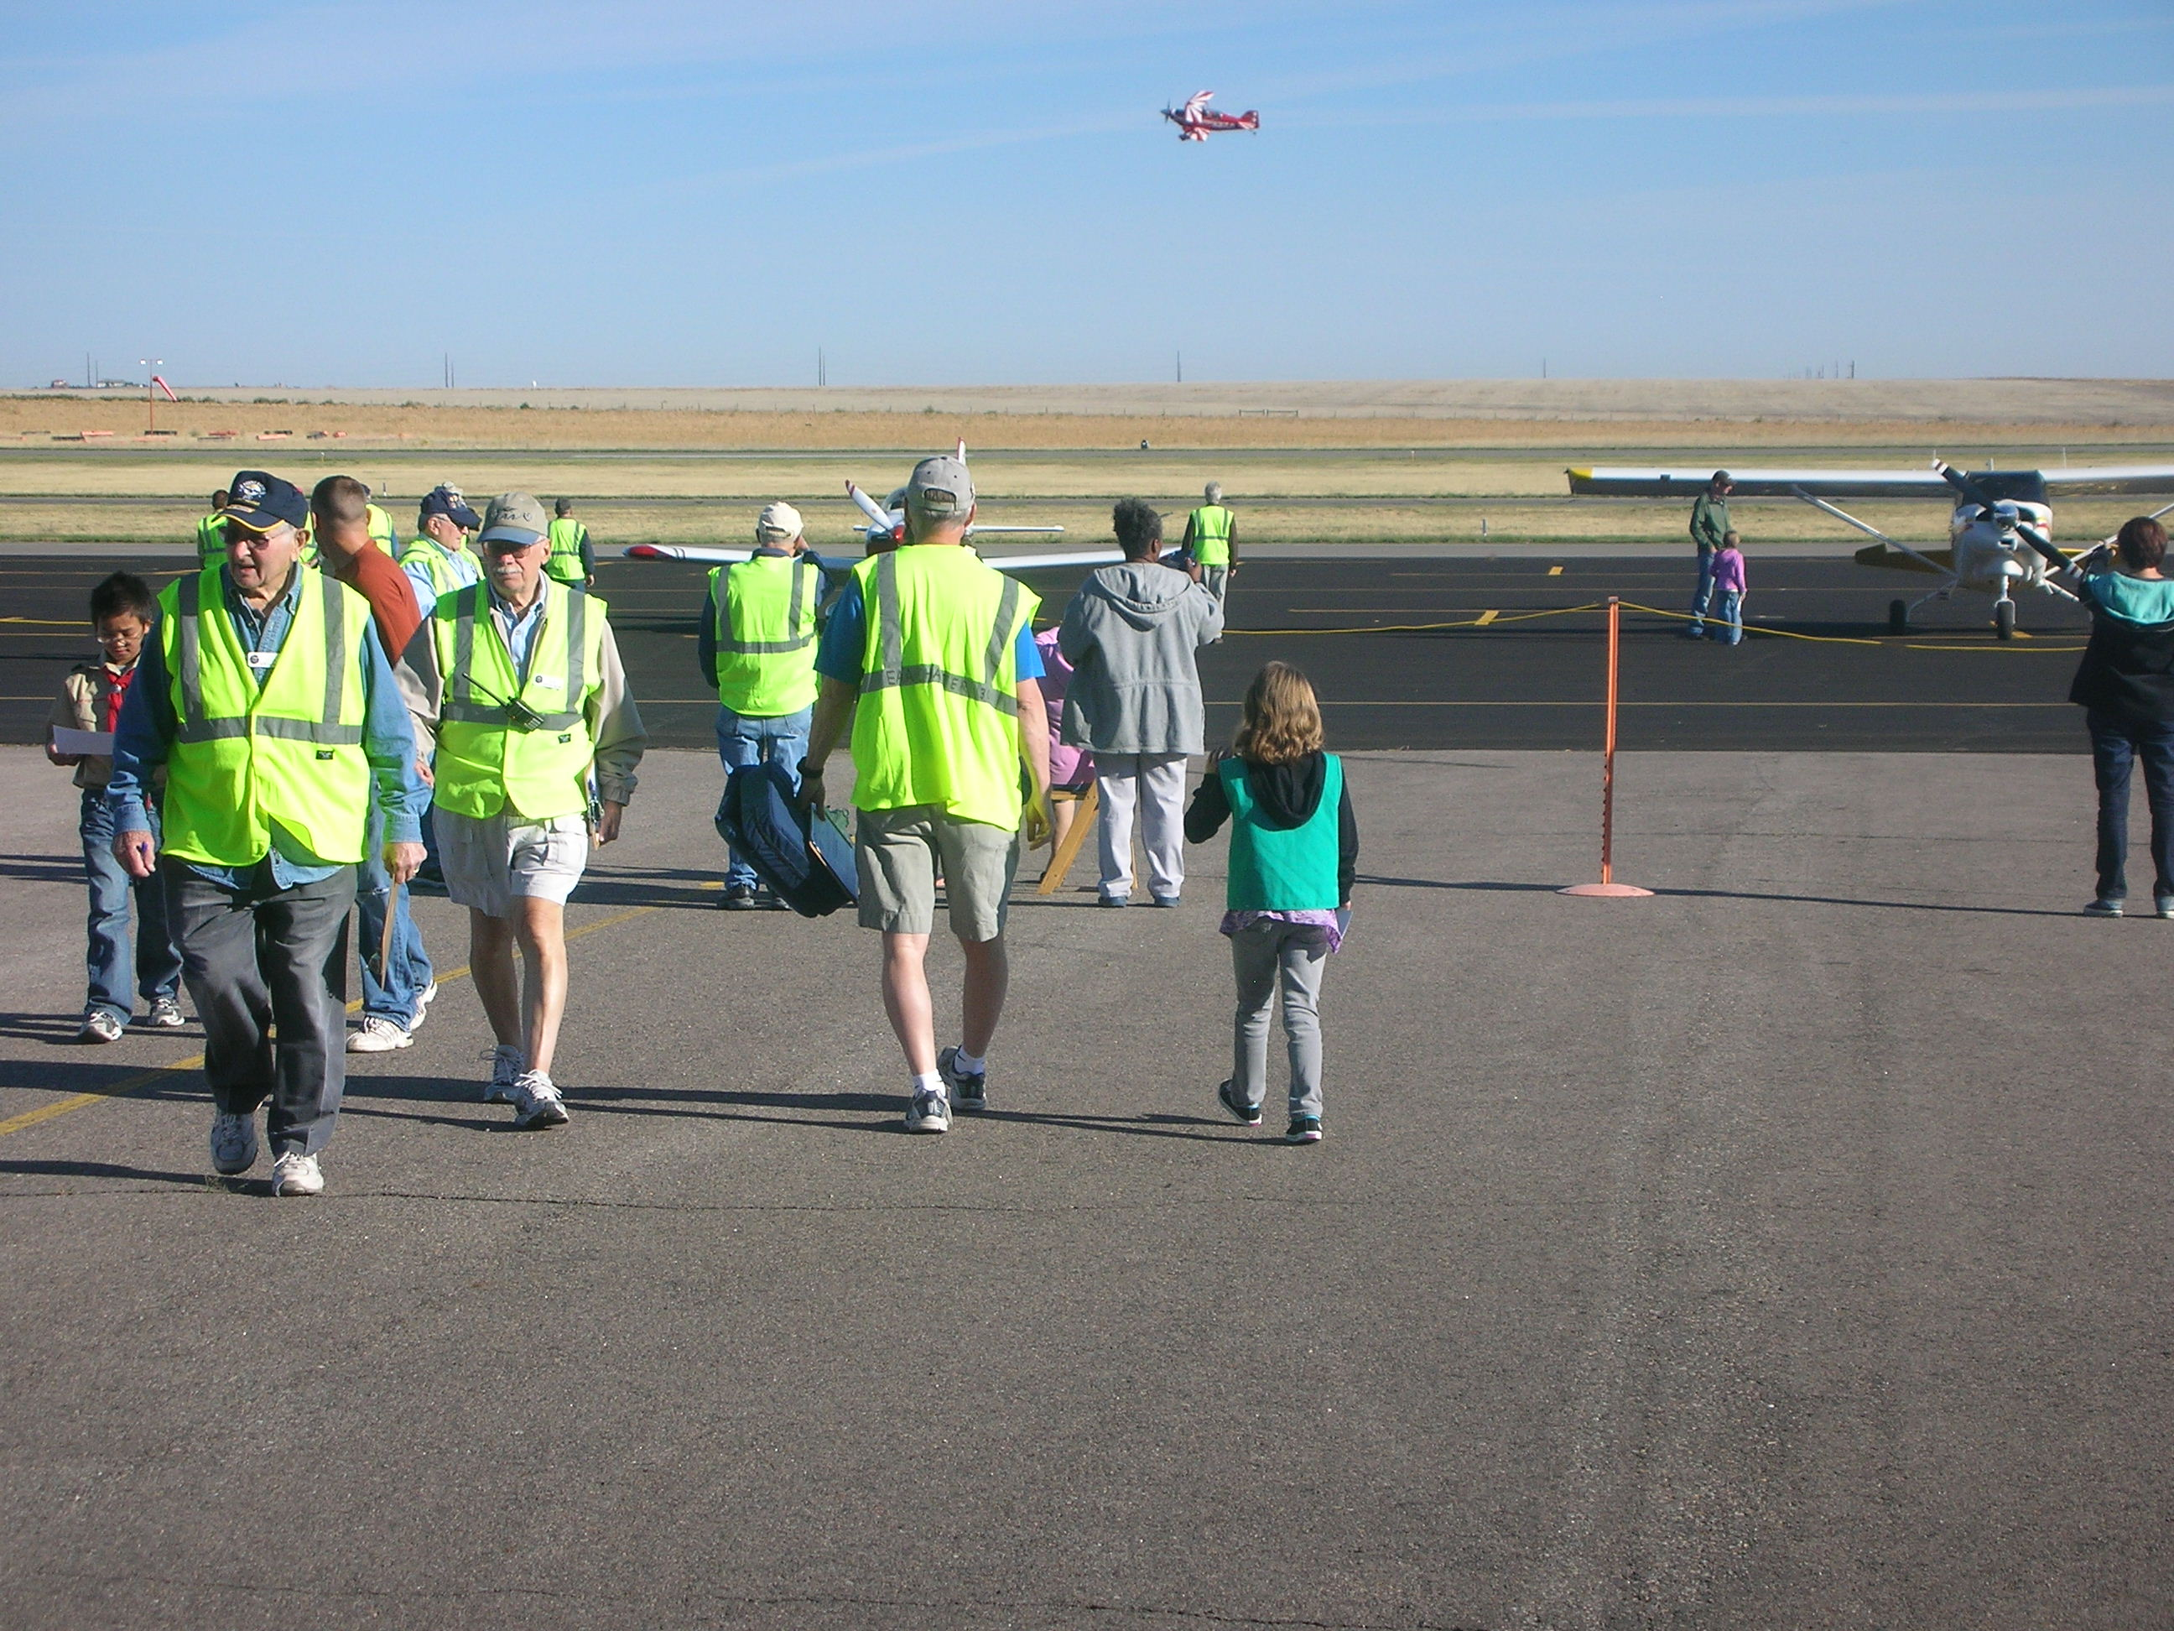
Notes:
You'll be escorted to the airplane.

Slide 66
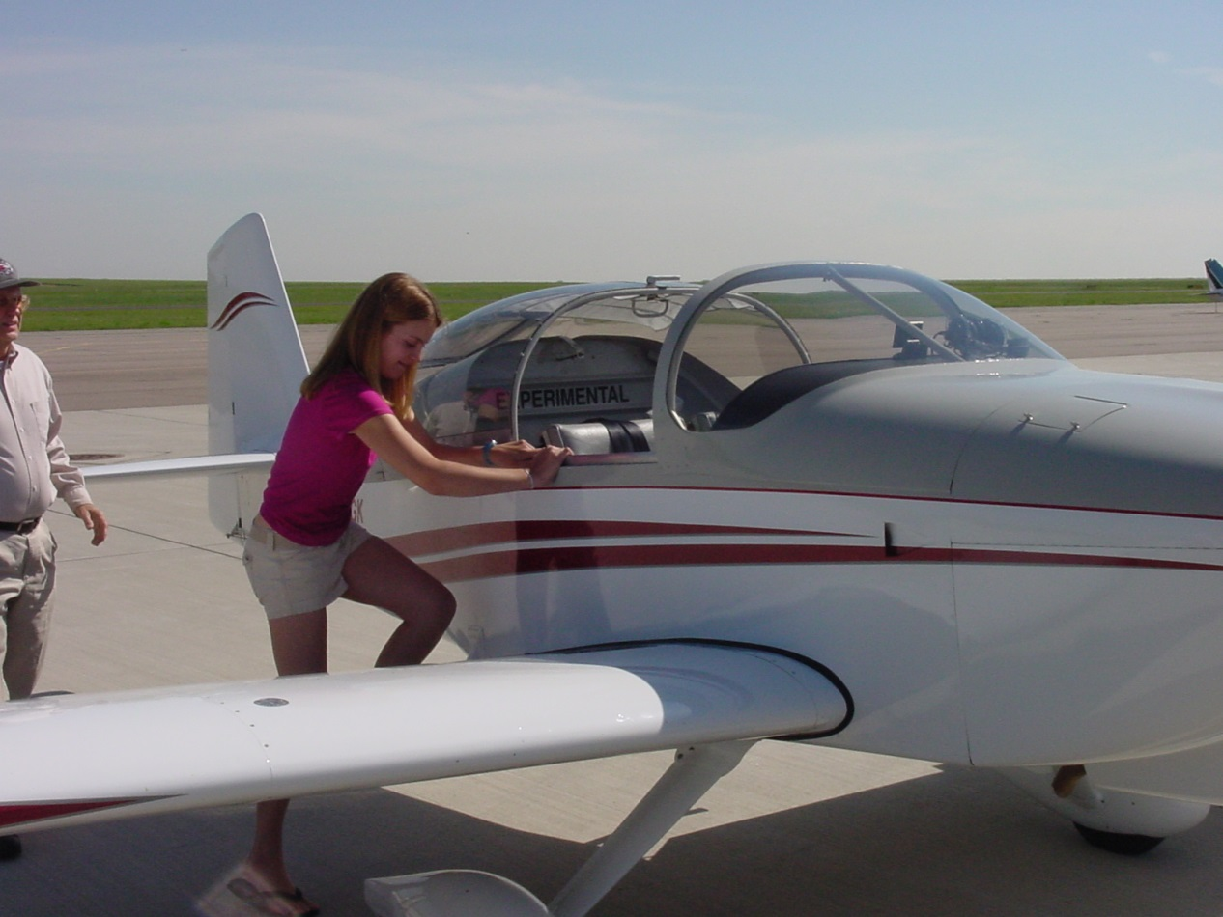

The Pilot will help you into the plane and make sure your seatbelt is secure.
Some airplanes have doors – others are "convertibles" and the climb in thru the "roof"
Notes:
Do NOT step on the wheel pant - it's for decoration.
Only step where the pilot tells you.
You do not have to fly, it's your choice.
You can have just as much fun enjoying the scenery from high above.
Do not let anyone embarass you or tease you - it's your choice.

Slide 67



Time to fly!
Up, Up & Away!

Slide 68



In the Air

Slide 69



But at some
point, you
have to
come back
to land

Slide 70
Good landings vs Great Landings?

Slide 71
Good landings vs Great Landings
Good landing: Any landing that you can walk away from
Great Landing: Any landing that you can re-use the airplane ☺

Slide 72

Results of a YE Flight:

Slide 73


After the flight, watch your step getting out.
Look at those Grins!

Slide 74


After your YE flight
Your pilot will sign your certificate.
Our photographer will take photos of you, the pilot & the airplane
Notes:
What's on the cert?
Pilot, N number, date, airplane, etc.
You can always look up the airplane on the FAA website.

Slide 75
Sporty’s Log Book
After your flight go back to the classroom and get your Sporty’s log book

Slide 76

World Record for the Largest Smile after a Young Eagles Flight

Slide 77
Where is your photo?
In a week or two, go to our website:
www.eaa301.org
Under Young Eagles Program click on “Young Eagles Images 2019”
Look for date of your flight, should be at top, and click on image to left for all photos.

Slide 78

THE END – GO HAVE FUN!

